Slide 1
TITLE OF PROJECT RICE GRADING
PROF: S.Raj kumar sir
TEAM-8
MEMBERS:
C.CHANDAN KUMAR.(16MIS1044)
M.DHANUSH KUMAR(16MIS1046)
V.CHANDRA SHEKAR(16MIS1096)
G.PAVAN KUMAR(16MIS1097)

Slide 2
SOFTWARE REQURIMENTS :
Mat lab (VERSION9.3.0.713579-64 bit.)
OBJECTIVES:
Checking the quality and grading of the rice grains.
PLAT FORMS:
matlab 2017b trail version
WORK DONE:
Converting the image into negative and find the impurities in the rice using matlab.

Slide 3
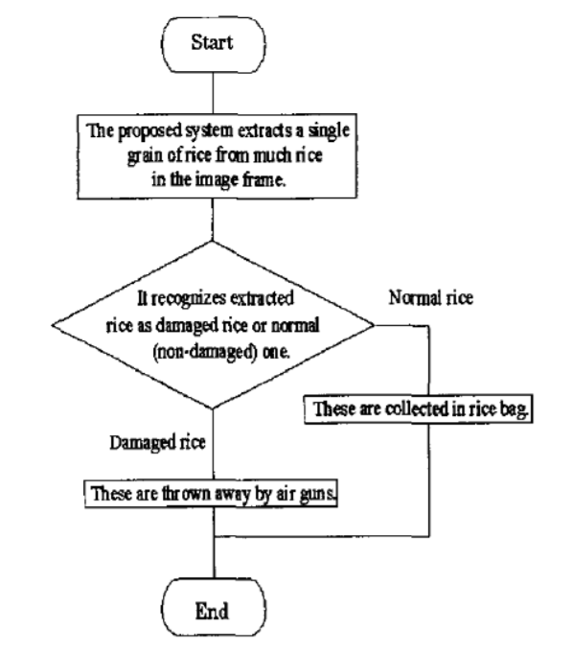
FLOW DIAGRAM:

Slide 4
IMPLEMENTATION DONE:
A1 = imread('insects.png'); A2 = imread('insects1.png'); A3 = imread('insects2.jpg'); A4 = imread('insects3.jpg');
B1 = imcomplement(A1); subplot(2,2,1), imshow(B1)
B2 = imcomplement(A2); subplot(2,2,2), imshow(B2)
B3 = imcomplement(A3); subplot(2,2,3), imshow(B3)
B4 = imcomplement(A4); subplot(2,2,4), imshow(B4)

Slide 5
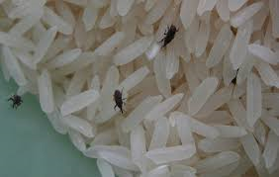
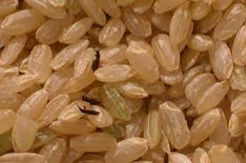
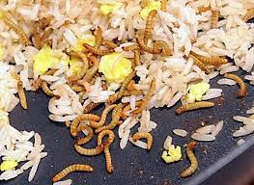
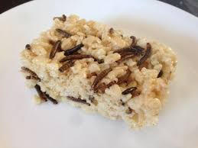
INPUT IMAGES:

Slide 6
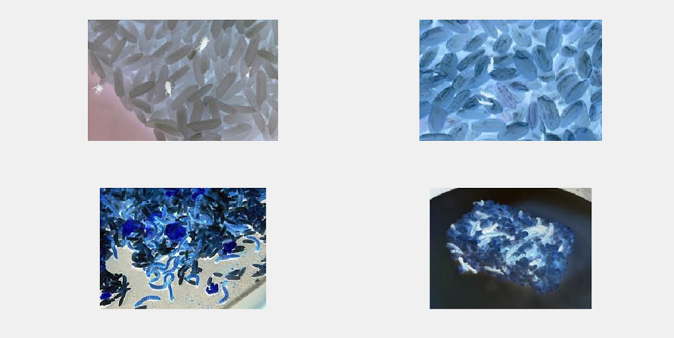
OUTPUT IMAGES:

Slide 7
WORK TO BE DONE IN NEXT REVIEW:
1.Color detection :
Classification of color also helpful in determined the quality of rice which it obtained the maturity, grade and growth defect of rice grains
2.Object detection.
3.Object Classification.

Slide 8
REFERENCES:
Paper by Wan Putri N. W. M. Tahir, Norhaida Hussin, Zaw Zaw Htike and Wai Yan Nyein Naing Department of Mechatronics Engineering, Faculty of Engineering, International Islamic University Malaysia, Malaysia
[1] D. M. Hobson, R. M. Carter, Y. Yan. 2007. “Characterisation and Identification of Rice Grains through Digital Image Analysis” University of Kent.
[2] Bin Lv, Bin Li, Sha Chen, Jian Chen, Bo Zhu. 2009. “Comparison of color techniques to measure the color of parboiled rice” Huazhong Agricultural University.
[3] Fumiaki Takeda, Hisaya Uchida, Take0 Tsuzuki, Hiroshi Kadota and Satoshi Shimanowhi. 2002. “A Proposal of Grading System for fallen rice using Neural Network”, Kochi University of Technology.

